Slide 1
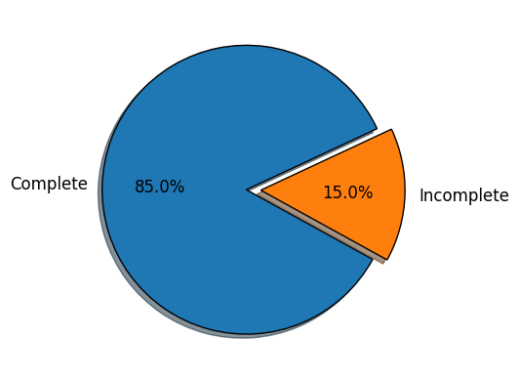
Predictive Modelling for customer bookings
Exploratory Data Analysis, Data Cleaning, Findings, Predictive Model

Slide 2
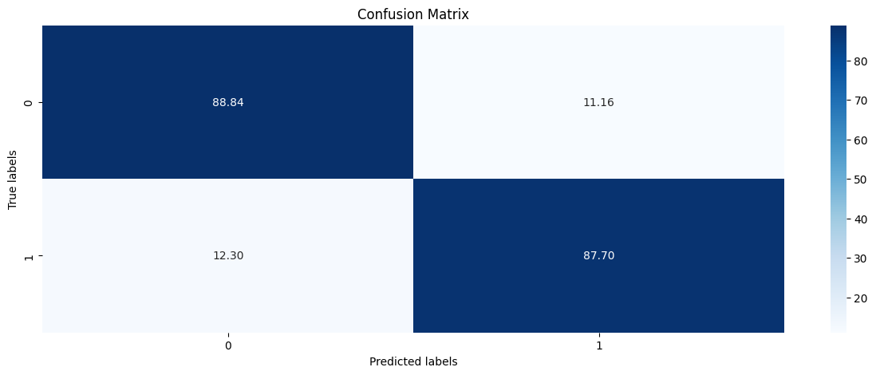
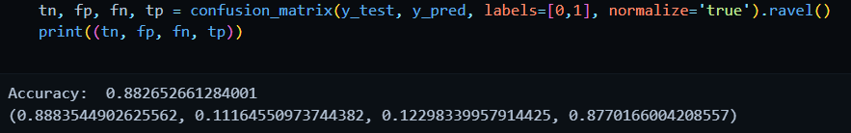
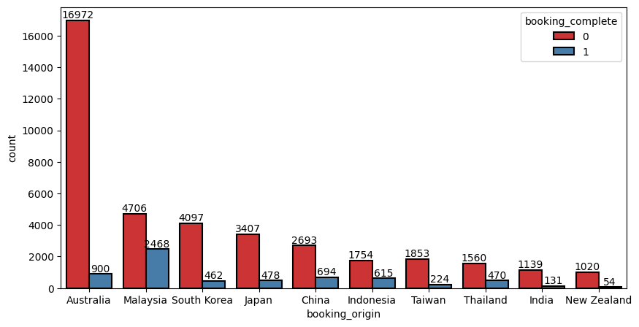
Most people travel alone.
If number of passengers > 1, they are more likely to complete booking. If number of passengers = 1 then completion pct = 16, if number of passengers = 2 then completion pct = 19%.
More audience use internet as compared to mobile.
Most chose round trip
Most people booked on Monday and Wednesday, so server should not be down for maintenance on these days. Less people book on Friday, Saturday and Sunday. We can have special deals on these days to increase number of bookings.
People who wanted extra baggage and did not have preferred seat booked more
People who wanted in flight meals were more likely to book
Even though the data shows that more people use BA in Australia, there are only 5.3% people that actually complete the booking whereas in Malaysia around 52% of the people complete the booking

